Slide 1
Competition, stability and change in the emergence of Brazilian Portuguese
Charlotte Galves, Unicamp/CNPq/Fapesp

Slide 2
The aim of the presentation
bring the case of Brazilian Portuguese to the debate on stability and change in language evolution, specifically in the situation of linguistic contact:
- describe changes induced by contact that led the variety of Portuguese emerged in Brazil to diverge from Romance languages;
- observe that this situation also led to an apparently stable morphological variation between innovative and conservative forms in the context of an innovative grammar;
- point out to a possible functional specialization of the conservative form.

Slide 3
Organization of the presentation
1. Structural innovations in Brazilian Portuguese arguably due to contact (work in collaboration with Juanito Avelar).
2. Morphological stability due to norm pressure.
3. Discussion of the result of the contact-induced change + the pressure of the norm: a new grammar with much morphological variation.

Slide 4
Structural innovations in Brazilian Portuguese due to contact.
1. Locative and genitive subjects

Slide 5
Locative subjects
1. As ruas do centro não tão passando carro.
the streets of-the downtown not be.3PL passing car
‘No cars are passing through downtown.’
2. algumas concessionárias tão caindo o preço [do carro]”
some dealerships be.3PL falling the price of-the car
‘The price of cars is dropping in some dealerships.’

Slide 6
Genitive subjects
3. As crianças tão nascendo o dente.
the children be.3P grow the tooth
‘The teeth of those children are growing.’
4. .“conheço pessoas que fizeram isso e caíram o cabelo”
know.1SG people that did that and fell.3PL the hair
‘I know people who did that and their hair fell out.’
http://br.answers.yahoo.com/question/index?qid=2008111908013
3AAFPQLS

Slide 7
Locative subjects in Bantu Languages
OTJIHERERO (Marten 2006: 98)
mò-ngàndá mw-á-hìtí òvá-ndú
18-9.house SC18-PAST-enter 2-people
‘Into the house/home entered (the) guests’
KINANDE (Baker 2003: exemplo 25)
Omo-mulongo mw-a-hik-a (?o-)mu-kali
LOC.18-village 18S-T-arrive-FV (AUG)-CL1-woman.1
‘At the village arrived a woman’
LUBUKUSU (Diercks 2011: 703)
Mú-mú-siirú mw-á-kwá-mó kú-mú-saala
18-3-forest 18s-PST-fall-18L3-3-tree
‘In the forest fell a tree’

Slide 8
Genitive subjects in bantu languages
CHICHEWA (Simango 2007: exemplo 23)
Mavuto a-na-f-a maso
Mavuto SM-PST-die-FV eyes
‘Mavuto became blind’ (Lit. ‘Mavuto died eyes’)
HAIA (Hyman 1977 apud Simango 2007)
Omwaana n-aa-shaash’ omutwe
child PR-he-ache head
‘The child has a headache’ (Lit. ‘The child is aching the head’)

Slide 9
Locative and genitive subjects in Mozambican Portuguese
5. Os olhos sairam lágrimas
The eyes came.PL out tears
' Tears came out from his/her eyes’
6. Ela nasceu dois filhos na Suazilândia
She was born two children in Suazilândia
'Two children of hers were born in Suazilândia.'
Gonçalves (2010)

Slide 10
Structural innovations in Brazilian Portuguese under contact.
2. The loss of casual marking on pronouns

Slide 11
7. Ele foi visto na escola. he was seen in the school
8a. A Maria viu ele na escola.
8b. % A Maria o viu na escola. ‘Maria saw him in the school.’
9. Você segue a Maria.
‘You follow Maria’
10a. Eu sigo você.
10b. Eu te sigo.
‘I follow you’

Slide 12
As noted by Creissels (2000: 233), “in the majority of African languages, both subjects and objects are unmarked for case, that is they do not exhibit any marking (affix, adposition or prosodic contour) distinguishing noun phrases in subject and object function from noun phrases quoted in isolation. This is in particular true of the overwhelming majority of Niger-Congo languages”.
About Kimbundu in particular, the grammar of Padre Dias points out that “personal pronouns don’t have declinations, nor variety of cases as Latin pronouns do. They are used in nominative and in others cases without varying” (2006 [1697]: 8).
(Avelar & Galves 2013)

Slide 13
Morphological stability under norm pressure.
Subject verb agreement
Pronominal clitic use and placement

Slide 14
Verbal agreement with third person plural 1980-2000 (Lucchesi et al. 2009: 348)
Afro-Brazilian communities, Bahia hinterland 16%
Uneducated fishmen communities, north of the State of Rio de Janeiro 38%
Uneducated people from the city of Rio de Janeiro 48%
Educated people from the city of Rio de Janeiro 73%
University-educated people from the city of Rio de Janeiro 94%

Slide 15
Clitic placement in the history of Brazilian Portuguese: the effect of the change in European Portuguese (Carneiro e Galves 2010)
Notes:
As for the first kind of competition, let’s have a look at what happens in historical texts in the case of clitic-placement. The green line is from a corpus of Portuguese texts at the beginning and of Brazilian texts from the 18th century on. The yellow line is from a corpus of Brazilian letters and the red line is from a corpus of Portuguese texts. All of the dots correspond to the relative frequency of enclisis in contexts in which both enclisis and proclisis are allowed: roughly affirmative root sentences in which the verb is not in absolute first position. The very interesting thing is that the two Brazilian corpora (yellow and green) display a increase of enclisis which parallels what happens in the Portuguese corpus (red line) more or less 100 years later. The huge difference between the Portuguese and the Brazilian texts is that in the former the change goes to completion since nowadays enclisis is obligatory in this context. In the two Brazilian corpora, however, the tendency reverts at the beginning of the 20th century. COMMENT

Slide 16
The result of strong linguistic contact: a new grammar with much morphological variation
Morphological variation is not the result of the competition of the old and the innovative grammar. It is the property of a new grammar.

Slide 17
Morphological variation inside an innovative grammar
Verbal agreement is variable but it occurs in contexts in which it is impossible in European Portuguese or in other Romance languages (cf. Locative and Genitive Subjects).
Clitic pronouns vary with strong pronouns. But Brazilian clitics are different from Portuguese clitics, both morphologically and syntactically.

Slide 18
European Portuguese (EP) has a morphological paradigm which is not found in Brazilian Portuguese (BP):
EP BP
1st person: me/nos me/?nos
2nd person: te/vos te/lhe
3rd person: o-a(s)/lhe(s) *
This shows that BP has clitics!
Notes:
Now I’ll bring 3 kinds of evidence against H1.

Slide 19
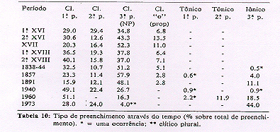
The evolution of the use of 3rd person - vs. 1st and 2nd person - clitics and non-clitics
The evolution of the use of object pronouns in plays (Cyrino 1996).
Notes:
This table, from Cyrino 1996 will allow us to contrast what happens in the third and in the second person in the history of BP. Let’s look first at third person. As we saw in the previous tables, the use of the 3rd person clitics drops at the end of the period considered. In fact, in the 1973 play, only one occurrence is found. Null objects are not considered here, but we see that the frequency of the 3rd person tonic pronoun correspondingly increases. Observe now the 2nd person. In 1960, there is no 2nd person clitic pronoun and the tonic pronoun (você) occupies all the space. However, somehow surprisingly, in 1973, 2nd person clitics reappear at a rate comparable with what is observed along the time, and there is no 2nd person tonic forms. So there is something different happening in this case.

Slide 20
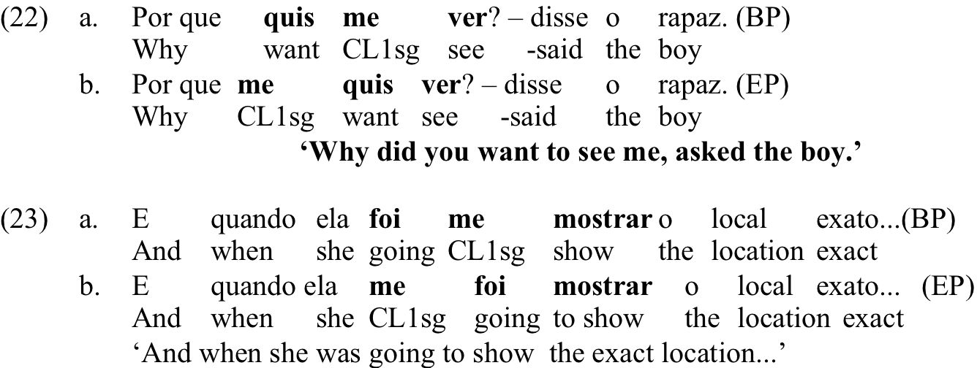
In EP, clitics affix to the inflected verb or auxiliary
In BP, clitics affix to the verb of which they are the argument.
(cf. Galves et al. 2006)
Notes:
The Portuguese version of Paulo Coelho.

Slide 21
As recently emphasized by the literature, in some dialects, Brazilian Portuguese displays 1rst and 2nd person clitic doubling ( Diniz 2007, Galves et al. forthcoming):
11. Eles te irrita ocê
They 2p.CL irritate you (Diniz 2007, p.49)
This is also found in acquisition data:
12. Me espera eu
1p.CL wait I (Raquel, 2;0.5. Magalhães 2006, p. 118)
This is incompatible with EP, which requires the preposition ‘a’ in the cases of doubling, and in which doubling expresses contrastive focalization, which is not the case in 11. and 12.

Slide 22
The te/você variation in D.O position
13. Eu no sábado espero você
I on Saturday wait you
(letter 1937 - Souza 2014)
14. Te acompanharei em muitas orações
2p.CL will accompany in many prays
(letter 1920 - Souza 2014)
15. Você vem buscar [e] e eu te vejo […].”
You come take (it) and I 2p.CL see
( Os 12 trabalhos 2006 -Silva 2011 )
16. Eu sigo você. Vá devagar.
I follow you. Go slowly
(Meu tio matou um cara 2004 – Silva 2011)
Notes:
I’ll concentrate now on what happens in the use of 2nd person pronouns. There is a variation, illustrated in 1 to 4 between strong pronouns and clitic pronouns. This variation is originally due to the extension of the use in subject position of the third person pronoun ‘você’ as the non-marked address form, in substitution, in many regions of Brazil, of the second person pronoun ‘tu’. From the 19th century on, in the parts of Brazil where você is used in competition with tu, or in complete substitution of tu, in subject position, te and você are in competition for the object position. It is important to emphasize that they are functionally equivalent. 1 and 2 are examples drawn from letters written in the first half of the 20th century. 3 and 4 are from a 21st century corpus of movies screenplays. In 3, we see that você in subject position co-exists with te in object position. Comparing 3 and 4, we see that você can appear either in subject or in object position.

Slide 23
The evolution of the use of the 2nd person clitic ‘te’ vs. the 2nd person full pronoun ‘você’ in diachrony (letters)
Cf. Souza 2014
period | te | você
1906-1930 | 132 - 97,1% | 4 – 2,9%
1931 - 1955 | 123 - 93,9% | 8 – 6,1%
1956 - 1980 | 38 - 69,1% | 17- 30,9%
Notes:
In this table, we see that from the beginning to the end of the 20th century there is a increasing use of the tonic pronoun você in object position.

Slide 24
The use of te (/lhe) e você in synchrony: variation studies in several Brazilian regions
 | você | te | Other 2nd p. pronouns | source
Salvador | 43 – 8% | 247 – 46% | lhe: 251 – 46% | Almeida 2009, p.128.
Rio de Janeiro | 16 – 13% | 109 – 85% | tu: 3 – 2% | Pimienta 2013, p.86
Brazilian movies (2000-2008) | 31 – 16,7% RJ 22 – 22% SP 8 - 14% POA 1- 3,4% | 151 – 81,2% RJ 77–77% SP 48-84,2% POA 26-89,7% | lhe: 4 – 2,2% RJ 1–1% SP 1–1,8% POA 2-6,9% | Oliveira Silva 2011, p.37.
Notes:
But when we look at the situation today, it seems that the 2nd person clitic te resists, and even reverts the tendency. Salvador is a special case because it has two different clitics for direct objects, the formerly 3rd person clitic lhe (which also appears in other regions, but much more marginally). If we look at Rio, and São Paulo in the corpus of movies, we see that the frequency of the second person clitic te is around 80%.

Slide 25
Conclusions about the data
Enclitic placement and the use of 3rd pronoun clitics are the effect of the influence of prestigious versions of Portuguese (both Classical and Modern European). This conclusion is reinforced by the fact that children don’t produce those forms before they go to school.
The dynamics of the use of 2nd person clitics is different. They continue to be extremely frequent in speech. Moreover, they are acquired by young children (Magalhães 2006). This is coherent with the fact that they are largely present in their PLDs.
The variation between the clitic form and the tonic form is not the effect of a competition of the same kind we see for 3rd person and for enclitic (vs. proclitic) placement. It is a genuine variation in spontaneous speech.
Notes:
Too bad he is not here!

Slide 26
Evidence of a stable variation
Cf. Wallenberg & Fruehwald (2015): either one form replaces the other or they specialize.
Specialization: for many speakers, te is loosing its [+ familiar] feature, as evidenced by the fact that it is compatible with the formal address “O Senhor/A Senhora”.
By contrast, você keeps its [+familiar] feature.

Slide 27
Conclusion
The data shown so far suggests that, due to the situation of contact characteristic of the emergence of Brazilian Portuguese, although speakers have been acquiring two distinct morphologies for 2nd person pronouns, one clitic and one non-clitic, the spoken vernacular does not evidence the existence of grammar competition between the old clitic grammar and the new non-clitic grammar. Instead, we observe a new grammar, which has a different clitic morphology and syntax.
The existence of clitic doubling without preposition suggests that in that grammar, at least for part of the speakers, clitics were reanalyzed as object agreement markers, as proposed -through different formulations- by many researchers. This explains the co-occurrence, both in the paradigm and in the syntax, of clitics and tonic pronouns. This might also explain the loss of the feature [+familiar].

Slide 28
Reflections for further research
Is “stable” variation between different grammars possible?
The facts from Brazilian Portuguese suggest that “stable variation” requires a unitary system in which both variants are licensed.
That is: it is competition internal to one grammar.
The contrast between 2nd and 3rd clitic pronouns in BP shows that in despite of the pressure of the norm, the new grammar has no means of licensing the latter. Impossible reanalysis of this kind could therefore be taken as hints for the understanding of what is at stake in specific grammatical changes.

Slide 29
Thank you!
charlotte.mgc@gmail.com
www.tycho.iel.unicamp.br

