Slide 1
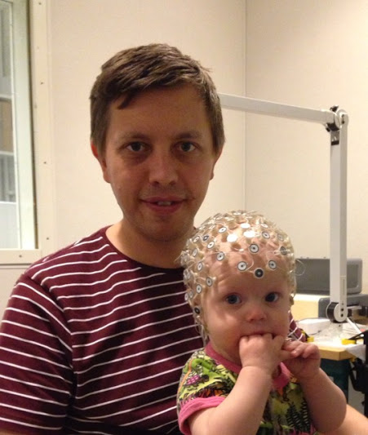
the role of frequency in measuring the rate of lexical replacement.
Susanne Vejdemo & Thomas Hörberg
Notes:
Focus on LEXICAL not grammatical stability an replacement. And on semantic and pragmatic, not e.g. sociolinguist, factors that affect this stability.

Slide 2
Talk motivated by
“It is unclear what the influence of type and token frequency is on keeping certain properties diachronically stable. On the one hand, research on grammaticalization has indicated that highly frequent items are more likely to grammaticalize, and therefore, low frequency of usage might be expected to favour stability. On the other hand, highly frequent elements often resist analogical change, so in this sense, ‘low frequency items’ are expected to be more prone to change.”

Slide 3
Frequency and stability
Token frequency
Type frequency
Raw frequency of occurrence
Frequency distribution
Entrenchment
Grammaticalization
Open class “content” lexical items
Closed class “function” grammatical items

Slide 4
Aim of presentation
Argue that the rate of lexical replacement for open and closed class lexical items should be analyzed separately.
Present a statistical model which partly predicts the rate of lexical replacement for open class lexical items.
Promote a discussion about the role of frequency.
Also: Present both positive and negative results – some hypotheses did not carry

Slide 5
Aim of presentation
Argue that the rate of lexical replacement for open and closed class lexical items should be analyzed separately.
Present a statistical model which partly predicts the rate of lexical replacement for open class lexical items.
Promote a discussion about the role of frequency.

Slide 6
Aim of presentation
Argue that the rate of lexical replacement for open and closed class lexical items should be analyzed separately.
Present a statistical model which partly predicts the rate of lexical replacement for open class lexical items.
Promote a discussion about the role of frequency.

Slide 7
The rate of lexical replacement
Take a group of related languages
Assume that they have a common proto language
Assume that the proto language had a single word X from a single cognate class Y for concept Z.
Since the time of the proto language, how many of the languages do NOT use a word from cognate class C to designate Z?
→ This is a measure of stability.
Notes:
A way to quantify how fast one concept is typically replaced in languages, compared to other concepts.
15 cog classes means AT LEAST 15 replacement.

Slide 8
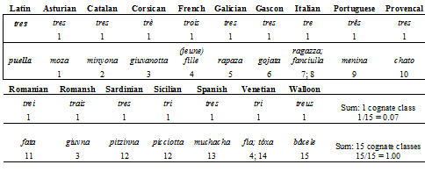
The rate of lexical replacement
“Stability Ranking” in Dolgopolsky (1986) “Retentiveness” in Lohr (1999)
THREE: 1 cognate class in 15 languages
GIRL: 15 cognate classes in 15 languages.
NUMBER OF COGNATE CLASSES
------------------------------------------- = RATE OF REPLACEMENT
NUMBER OF LANGS IN SAMPLE
Notes:
A way to quantify how fast one concept is typically replaced in languages, compared to other concepts.
15 cog classes means AT LEAST 15 replacement.

Slide 9
Aim of presentation
Argue that the rate of lexical replacement for open and closed class lexical items should be analyzed separately.
Present a statistical model which partly predicts the rate of lexical replacement for open class lexical items.
Promote a discussion about the role of frequency.

Slide 10
Pagel et al (2007)
Calculated a rate of lexical replacement*
used database from Dyen et al (1992):
200 concepts (Swadesh list), data from 87 IE langs
Did not differentiate between open and closed class items.
*...Using a more complicated formula than the one presented on the earlier slide, but with the same end results...

Slide 11
Pagel et al (2007)
Linear regression model:
Frequency: predicts 13% of the variation in Rate.
Frequency + wordclass: predicts 50% of Rate.
Lemma; BNC
“wordclass” for a concept?!
Assigned on semantic criteria (?)
Common in this kind of databases: e.g. in Austronesian Basic Vocabulary Database.

Slide 12
Pagel et al (2007)
173 open class items (noun, adj, verb), 27 closed class.
Closed Class Items:
Small samples
High frequency
Open Class Items:
Larger samples
Lower frequency
Lemma; BNC

Slide 13
Pagel et al (2007)
Linear regression model (200 open+closed items):
Frequency + wordclass: predicts 50% of Rate.
BUT:
Same linear regression model (27 closed items):
Frequency + wordclass: predicts 60% of Rate.
Same linear regression model (173 open class items):
Frequency + wordclass: predicts 12% of Rate.

Slide 14
Aim of presentation
Argue that the rate of lexical replacement for open and closed class lexical items should be analyzed separately.
Present a statistical model which partly predicts the rate of lexical replacement for open class lexical items.
Promote a discussion about the role of frequency.
Notes:
There are also other reasons why they should be analyzed separately: a lot of research shows that they are handled in different parts of the mind.

Slide 15
Aim of presentation
Argue that the rate of lexical replacement for open and closed class lexical items should be analyzed separately.
Present a statistical model which partly predicts the rate of lexical replacement for open class lexical items.
Promote a discussion about the role of frequency.

Slide 16
A new model
Dependent variable:
The rate of lexical replacement (Pagel et al 2007)
Independent variables:
What hypotheses are there about semantic/pragmatic factors that affect the rate of lexical replacement for open class lexical items?

Slide 17
A new model – independent variables:
Higher entrenchment → Lower rate
Frequency (BNC Lemma; Pagel et al.)
Collocational strength (Mutual Information, BNC)
Senses (Wordnet)
Easier inferencing → Higer rate
Synonyms (Dictionaries)
More abstract concept→ Higher rate
Imageability/Concreteness (Cortese & Fugett 2004)
Word class (Pagel et al.)
Earlier learned concept → Lower rate
Age of Acquisition (Monaghan 2015)
Higher emotional charge → Higher rate
Arousal (Warriner et al 2013)

Slide 18
A new model – independent variables:
Higher entrenchment → Lower rate
Frequency (BNC Lemma; Pagel et al.)
Collocational strength (Mutual Information, BNC)
Senses (Wordnet)
Easier inferencing → Higer rate
Synonyms (Dictionaries)
More abstract concept→ Higher rate
Imageability/Concreteness (Cortese & Fugett 2004)
Word class (Pagel et al.)
Earlier learned concept → Lower rate
Age of Acquisition (Monaghan 2015)
Higher emotional charge → Higher rate
Arousal (Warriner et al 2013)
“frequency in particular constructions”

Slide 19
Collocational strength?
English | Freq (per mill. words) | Rate of lexical replacement | MI (averaged from top 20 co-occurring words)
Belly | 32 | 4.39 | 1.93
Egg | 34 | 1.57 | 9.33
Similar raw frequency
Very different rate...
... Explained by MI value?
Belly ha a LOW average MI: It does not often co-occur with the same other words
Egg has a HIGH average MI: It often occurs in the same constructions again and again:
i.e. it co-occurs with the same words (e.g. yolk)
Notes:
Syntagmatic relationship / Distributional frequency profile

Slide 20
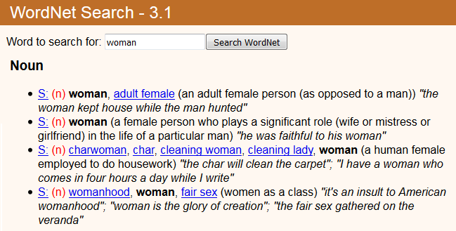
Senses
Cortese & Fugett

Slide 21
A new model – independent variables:
Higher entrenchment → Lower rate
Frequency (BNC Lemma; Pagel et al.)
Collocational strength (Mutual Information, BNC)
Senses (Wordnet)
Easier inferencing → Higer rate
Synonyms (Dictionaries)
More abstract concept→ Higher rate
Imageability/Concreteness (Cortese & Fugett 2004)
Word class (Pagel et al.)
Earlier learned concept → Lower rate
Age of Acquisition (Monaghan 2015)
Higher emotional charge → Higher rate
Arousal (Warriner et al 2013)

Slide 22
Synonyms?
How can this be measured?

Slide 23
A new model – independent variables:
Higher entrenchment → Lower rate
Frequency (BNC Lemma; Pagel et al.)
Collocational strength (Mutual Information, BNC)
Senses (Wordnet)
Easier inferencing → Higer rate
Synonyms (Dictionaries)
More abstract concept→ Higher rate
Imageability/Concreteness (Cortese & Fugett 2004)
Word class (Pagel et al.)
Earlier learned concept → Lower rate
Age of Acquisition (Monaghan 2015)
Higher emotional charge → Higher rate
Arousal (Warriner et al 2013)

Slide 24
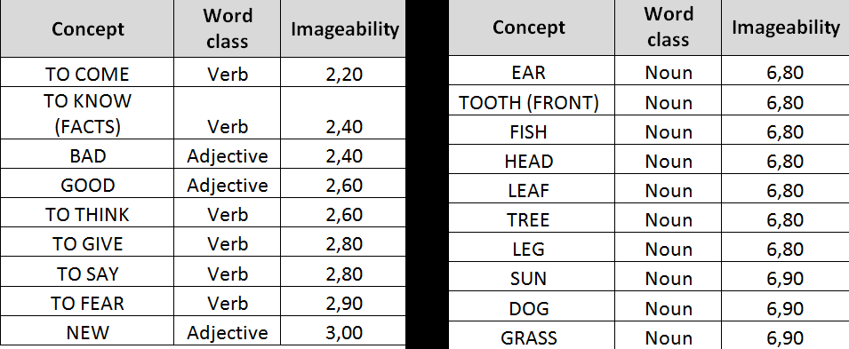
Imageability
“On a scale from 1 to 7 how easy is it to picture the meaning of the following word in your mind?”

Slide 25
A new model – independent variables:
Higher entrenchment → Lower rate
Frequency (BNC Lemma; Pagel et al.)
Collocational strength (Mutual Information, BNC)
Senses (Wordnet)
Easier inferencing → Higer rate
Synonyms (Dictionaries)
More abstract concept→ Higher rate
Imageability/Concreteness (Cortese & Fugett 2004)
Word class (Pagel et al.)
Earlier learned concept → Lower rate
Age of Acquisition (Monaghan 2015)
Higher emotional charge → Higher rate
Arousal (Warriner et al 2013)

Slide 26
Age of Acquisition
Earlier learnt words are the last to be forgotten by old people.
Earlier learnt words might be deeper entrenched.
Data from Monaghan (2015), who found a significant effect on the rate of lexical replacement.

Slide 27
A new model – independent variables:
Higher entrenchment → Lower rate
Frequency (BNC Lemma; Pagel et al.)
Collocational strength (Mutual Information, BNC)
Senses (Wordnet)
Easier inferencing → Higer rate
Synonyms (Dictionaries)
More abstract concept→ Higher rate
Imageability/Concreteness (Cortese & Fugett 2004)
Word class (Pagel et al.)
Earlier learned concept → Lower rate
Age of Acquisition (Monaghan 2015)
Higher emotional charge → Higher rate
Arousal (Warriner et al 2013)

Slide 28
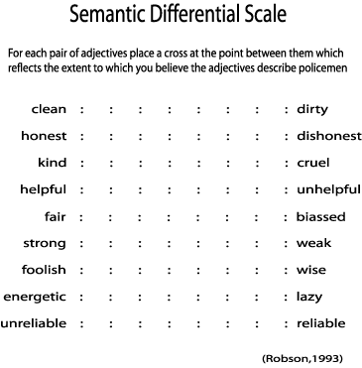
Arousal
How can this be measured?
Semantic Differential experiments (pioneered by Osgood 1957).
English arousal measurements from Warriner et al (2013)
Notes:
Psychologists have a way of measuring one kind of emotional charge, that they call arousal, using Semantic Differential experiments that you might remember from your semantics 101 classes. I won’t go into how these experiments are done at the moment. Suffice is to say that they measure the emotional charge of for instance Dutch pater and vader. (DUTCH SPEAKERS?).

Slide 29
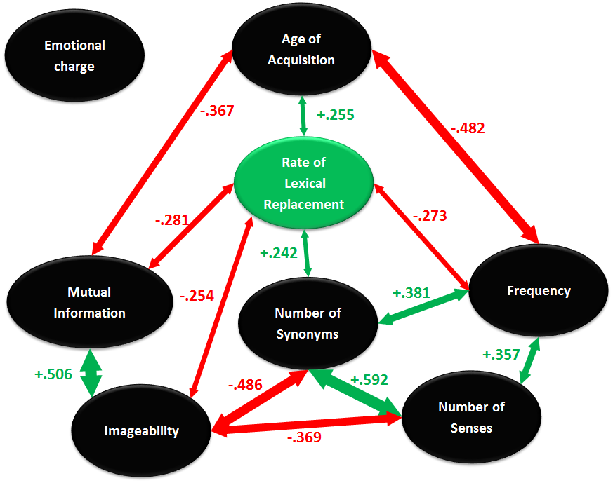
A new model – correlation results
Bonferroni-Holm adjusted

Slide 30
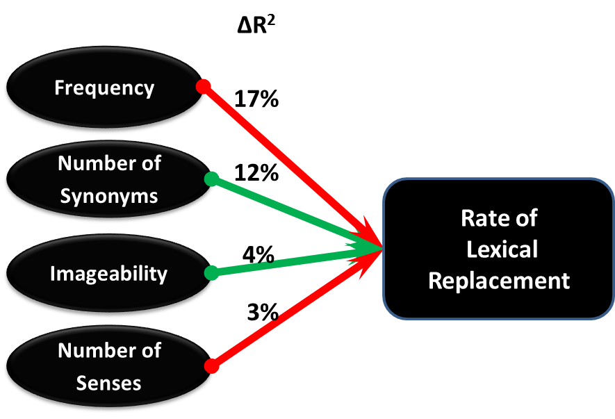
A new model – linear regression results
Model explains 34% of the variation.
Results’ reliability checked by bootstrapping.
No collinearity issues

Slide 31
Comparison of models for OPEN CLASS items
Pagel et al (2007):
Frequency + Word class: 12%
Vejdemo & Hörberg (2016)
Frequency +Imageability +Synonyms +Senses: 34%

Slide 32
Aim of presentation
Argue that the rate of lexical replacement for open and closed class lexical items should be analyzed separately.
Present a statistical model which partly predicts the rate of lexical replacement for open class lexical items.
Promote a discussion about the role of frequency.

Slide 33
Aim of presentation
Argue that the rate of lexical replacement for open and closed class lexical items should be analyzed separately.
Present a statistical model which partly predicts the rate of lexical replacement for open class lexical items.
Promote a discussion about the role of frequency.

Slide 34
What is frequency?
Raw frequency
Distributional frequency profile
Type frequency vs. Token frequency

Slide 35
What do we know about type/token freq?
Bybee 2007, Pfäder&Behrens 2016:
High token frequency of an item has a
…Conserving effect…
…is connected to less lexical replacement.
… because it is connected to higher entrenchment(?)
...Reducing effect...
…It leads to more phonetic attrition.
…It leads to more semantic attrition.
High type frequency of a construction...
…Leads to generalization and schema formation
(Bybee 2007; Pfäder & Behrens 2016)

Slide 36
Frequency of FORM, frequency of CONCEPT
High token frequency → High form retention/low replacement.

Slide 37
Frequency of FORM, frequency of CONCEPT
What is ”type frequency” from a semantic view:
If the CONCEPT is frequent, and expressed with many words, it is similar to when a grammatical construction is frequent, and expressed with many different words.
Construction: VERB-ed – instantiated as walk-ed, talk-ed, kill-ed.
Concept: WOMAN – instantiated as woman, lady, female, etc.
Many synonyms mesures a high semantic type frequency.
As found for grammatical type frequency, a high type frequency does not lead to entrenchment, but to generalization and schema formation.
Semantically, the corollary is that it leads to conceptual entrenchment, NOT form entrenchment.
→ High semantic type frequency does not insulate from lexical replacement...
... In fact, availability of many different forms (many synonyms) leads to easier inferencing → higher replacement.

Slide 38
How is frequency related to other measurements?
High lexical freq.
High concept freq
(i.e. high semantic type frequency)
Spread frequency distribution

Slide 39
Final musings
A lot of frequency effects are better explained by other, correlated, factors (e.g. synonymy).
Things we have learned about frequency effects for GRAMMATICAL language items may be applied, but if so cautiously, to lexical language items.
Schmid (2010:125) notes that “we have understood neither the nature of frequency itself nor its relation to entrenchment”.
...But we understand it a bit better year by year...

Slide 40
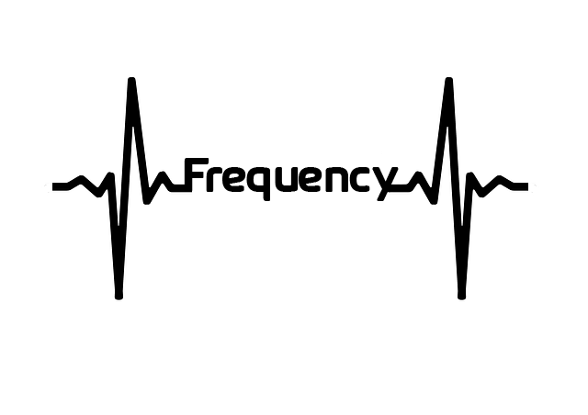
Thanks!
Thank you for your time!
What are your thoughts on this matter?

Slide 41
BONUS SLIDES

Slide 42
The rate of lexical replacement
Simplistic measurement:
Pagel et al (2007) measurement:
Simplistic measurement vs Pagel et al measurement:
Extremely similar: R=0.98
This study: Pagel et al measurement, for comparability.
NUMBER OF COGNATE CLASSES
------------------------------------------- = RATE OF REPLACEMENT
NUMBER OF LANGS IN SAMPLE
NUMBER OF COGNATE CLASSES
------------------------------------------- [language distance] = RATE OF REPLACEMENT
NUMBER OF LANGS IN SAMPLE

Slide 43
Collocational strength?
English | Freq (per mill. words) | Rate of lexical replacement | MI
BELLY | 32 | 4.39 | 1.93
EGG | 34 | 1.57 | 9.33
 | Frequency near belly | Total Frequency | % of total frequency that is near belly | MI
BEER | 19 | 3133 | 0.61 | 6.78
WHITE | 33 | 23111 | 0.14 | 4.69
FULL | 16 | 27781 | 0.06 | 3.38
HER | 149 | 301315 | 0.05 | 3.16
HIS | 146 | 404811 | 0.04 | 2.7
MY | 47 | 145250 | 0.03 | 2.55
ITS | 44 | 158200 | 0.03 | 2.33
…etc… | …etc… | …etc… | …etc… | …etc…
Average MI |  |  |  | 1.93
Notes:
Syntagmatic relationship / Distributional frequency profile

Slide 44
Collocational strength?
English | Freq (per mill. words) | Rate of lexical replacement | MI
BELLY | 32 | 4.39 | 1.93
EGG | 34 | 1.57 | 9.33
 | Frequency near egg | Total Frequency | % of total frequency that is near egg | MI
YOLKS | 81 | 97 | 83.51 | 11.12
HARD-BOILED | 52 | 72 | 72.22 | 10.91
FERTILIZED | 58 | 107 | 54.21 | 10.49
YOLK | 52 | 105 | 49.52 | 10.36
QUAILS | 27 | 64 | 42.19 | 10.13
FERTILISED | 37 | 91 | 40.66 | 10.08
SPERMS | 15 | 39 | 38.46 | 10
…etc… | …etc… | …etc… | …etc… | …etc…
Average MI |  |  |  | 9.33

Slide 45
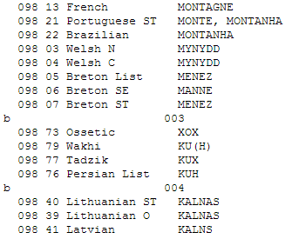
Pagel et al (2007)
Calculated a rate of lexical replacement
used database from Dyen et al (1992):
200 concepts (Swadesh list), data from 87 IE langs
Did not differentiate between open and closed class items.

